Slide 1
GPU Implementation of Data-Aided Equalizers
Jeff Ravert
Advisor: Michael Rice

Slide 2
Outline
Introduction
Problem statement
System Overview
Signal processing in GPUs
Equalizer implementation and performance

Slide 3
Introduction - Multipath
Multipath interference is one of the dominant causes for link loss in aeronautical telemetry

Slide 4


Introduction - Multipath
Multipath interference is one of the dominant causes for link loss in aeronautical telemetry

Slide 5
Introduction - Multipath
Multipath interference is one of the dominant causes for link loss in aeronautical telemetry

Slide 6
Introduction - Multipath
Multipath interference is one of the dominant causes for link loss in aeronautical telemetry

Slide 7
Introduction - Multipath
Multipath interference is one of the dominant causes for link loss in aeronautical telemetry

Slide 8
Introduction - Multipath
Multipath interference is one of the dominant causes for link loss in aeronautical telemetry

Slide 9
Introduction - Multipath
Multipath interference is one of the dominant causes for link loss in aeronautical telemetry

Slide 10
Introduction - Equalizers
Blind equalizers
Adaptive filters
Use known statistical properties of the transmitted signal
Have no knowledge of the data or multipath channel
Data-aided equalizers
Filters calculated from the estimated propagation conditions
Use known data sequences of the transmitted signal
Estimate the multipath channel using the known data

Slide 11
Introduction - PAQ Project
The Preamble Assisted Equalization (PAQ) project compares the real-time bit error rate (BER) performance of
Blind equalizer (Quasonix)
No equalizer
Five data-aided equalizers
Zero-forcing (ZF)
Minimum Mean-square Error (MMSE)
MMSE-initialized Constant Modulus Algorithm (CMA)
Frequency Domain Equalizer One (FDE1)
Frequency Domain Equalizer Two (FDE2)

Slide 12
Introduction - PAQ Project
T/M Receiver & Demod
RF
70 MHz IF
Samples
T/M Receiver
ADC
Host CPU
Host CPU
FPGA
FPGA
BERT
K40c GPU
K20c GPU
K20c GPU
Rack Mounted Server
Rack Mount Case

Slide 13
Introduction - PAQ Project
T/M Receiver & Demod
No Equalizer
Bits
RF
70 MHz IF
Samples
T/M Receiver
ADC
Host CPU
Host CPU
FPGA
FPGA
BERT
K40c GPU
K20c GPU
K20c GPU
Rack Mounted Server
Rack Mount Case

Slide 14
Introduction - PAQ Project
T/M Receiver & Demod
No Equalizer
Bits
Blind Equalizer
Bits
RF
70 MHz IF
Samples
T/M Receiver
ADC
Host CPU
Host CPU
FPGA
FPGA
BERT
K40c GPU
K20c GPU
K20c GPU
Rack Mounted Server
Rack Mount Case

Slide 15
Introduction - PAQ Project
T/M Receiver & Demod
No Equalizer
Bits
Blind Equalizer
Bits
RF
70 MHz IF
Samples
T/M Receiver
ADC
Host CPU
Host CPU
FPGA
FPGA
BERT
Data-aided
Equalizer Bits
K40c GPU
K20c GPU
K20c GPU
Rack Mounted Server
Rack Mount Case

Slide 16
Introduction - PAQ Project
T/M Receiver & Demod
No Equalizer
Bits
Blind Equalizer
Bits
RF
70 MHz IF
Samples
T/M Receiver
ADC
Host CPU
Host CPU
FPGA
FPGA
BERT
Data-aided
Equalizer Bits
K40c GPU
K20c GPU
K20c GPU
1.907 Seconds
of Samples
Rack Mounted Server
Rack Mount Case

Slide 17
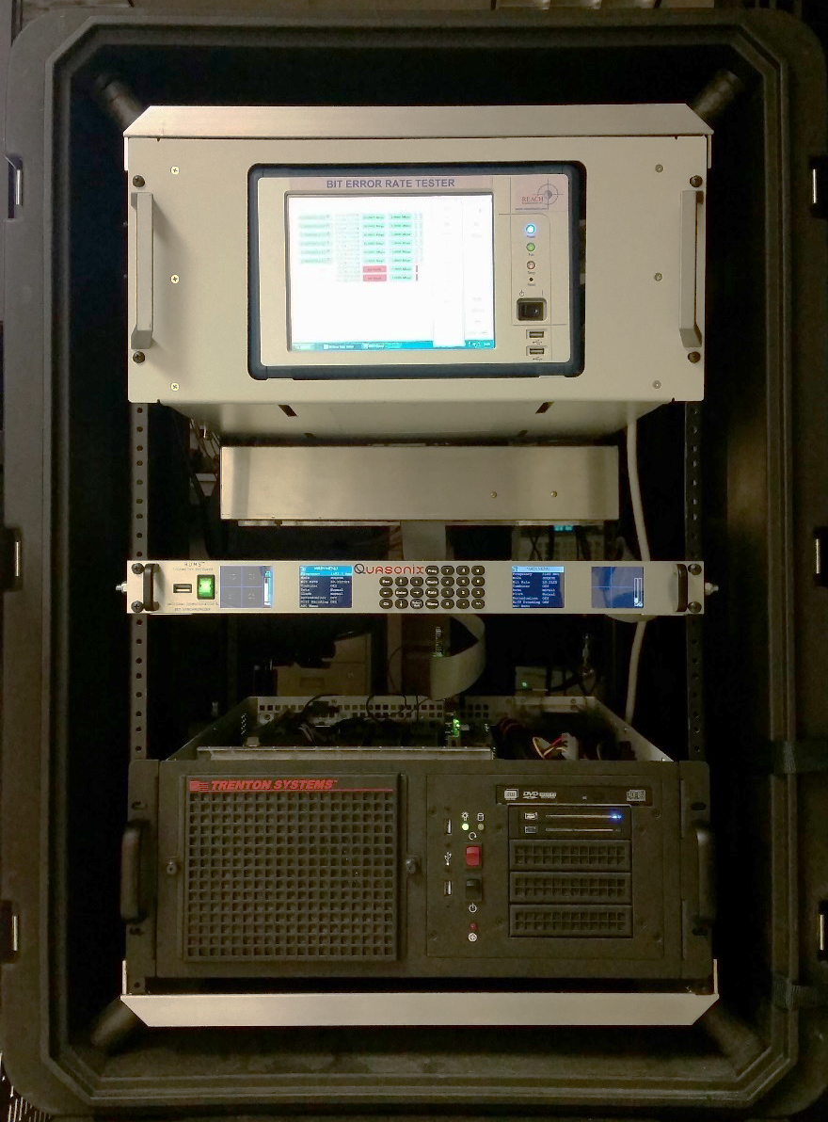
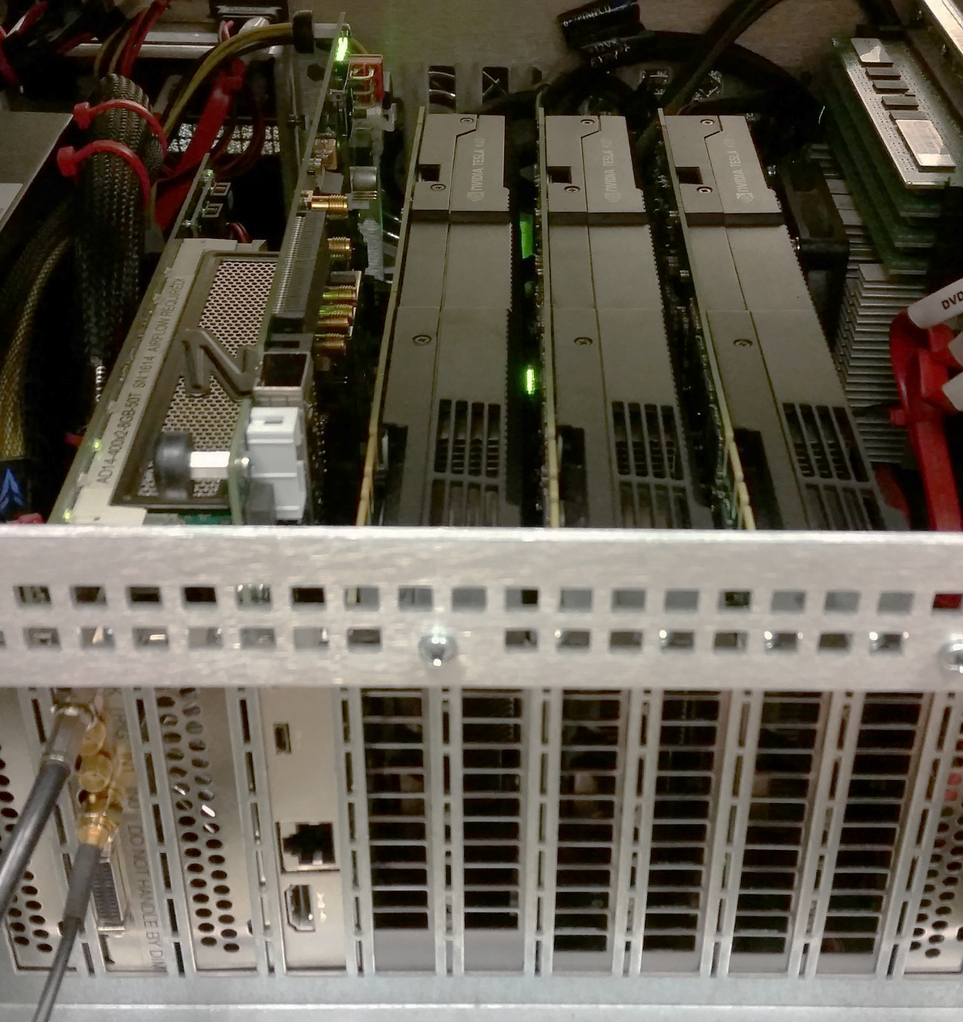
Introduction - PAQ Project
Host
CPU
BERT
T/M Receiver
Rack Mounted
Server
Rack Mount
Case
ADC
FPGA
K40c
GPU
K20c
GPU
K20c
GPU

Slide 18
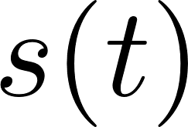

Introduction - Signal Block Diagram
Transmitter
Transmitted
Signal
iNET
Packet
SOQPSK-TG
Modulator
Data Bits

Slide 19
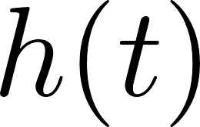
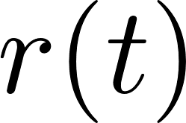

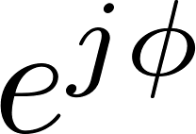

Introduction - Signal Block Diagram
Transmitter
Transmitted
Signal
Distortions
iNET
Packet
SOQPSK-TG
Modulator
Channel
Data Bits

Slide 20
Introduction - Signal Block Diagram
Transmitter
Transmitted
Signal
Distortions
iNET
Packet
SOQPSK-TG
Modulator
Channel
Data Bits
RF
Down-Convert &
Filter
IF
Received Signal
Receiver

Slide 21
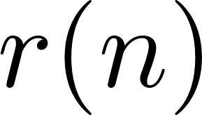
Introduction - Signal Block Diagram
Transmitter
Transmitted
Signal
Distortions
iNET
Packet
SOQPSK-TG
Modulator
Channel
Data Bits
RF
Down-Convert &
Filter
Resample
IF
ADC
Received Signal
Receiver
Server

Slide 22
Introduction - Signal Block Diagram
Transmitter
Transmitted
Signal
Distortions
iNET
Packet
SOQPSK-TG
Modulator
Channel
Data Bits
RF
Down-Convert &
Filter
Resample
IF
ADC
Received Signal
Receiver
Server
128 bits
64 bits
6144 bits
Preamble
ASM
Data
6336 bits
Data
Preamble
ASM
Data
Preamble
ASM
Data

Slide 23
Introduction - iNET Packet
The known Preamble and ASM data sequences are used to estimate:
Frequency offset
Channel impulse response
Noise variance
128 bits
64 bits
6144 bits
Preamble
ASM
Data
12672 samples at 2 samples/bit
Data
Preamble
ASM
Data
Preamble
ASM
Data

Slide 24




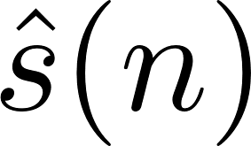
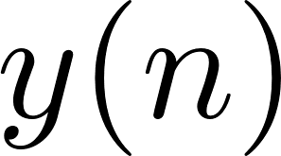
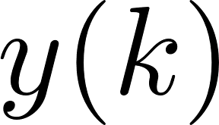
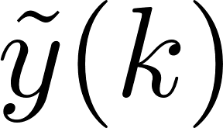




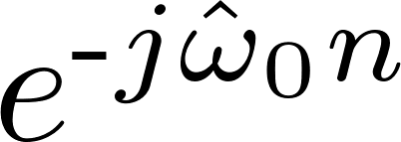
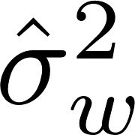
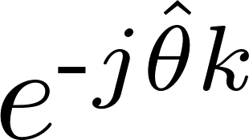
Introduction - PAQ Signal Processing
Preamble
Detector
Equalize
Detection
Filter
Frequency
Offset
Estimator
PLL
Estimators

Slide 25
Introduction - PAQ Signal Processing
Preamble
Detector
Equalize
Detection
Filter
2
Frequency
Offset
Estimator
PLL
Estimators
1.907 Seconds is 3103 or 3104 iNET Packets

Slide 26
Introduction - PAQ Signal Processing
Preamble
Detector
Equalize
Detection
Filter
2
Frequency
Offset
Estimator
PLL
Estimators
1.907 Seconds is 3103 or 3104 iNET Packets

Slide 27
Introduction - PAQ Signal Processing
186 Taps
Preamble
Detector
Equalize
Detection
Filter
2
Frequency
Offset
Estimator
PLL
Estimators
1.907 Seconds is 3103 or 3104 iNET Packets

Slide 28
Introduction - PAQ Signal Processing
186 Taps
23 Taps
Preamble
Detector
Equalize
Detection
Filter
2
Frequency
Offset
Estimator
PLL
Estimators
1.907 Seconds is 3103 or 3104 iNET Packets

Slide 29
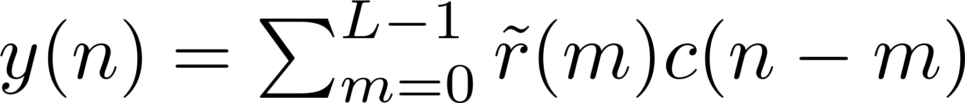
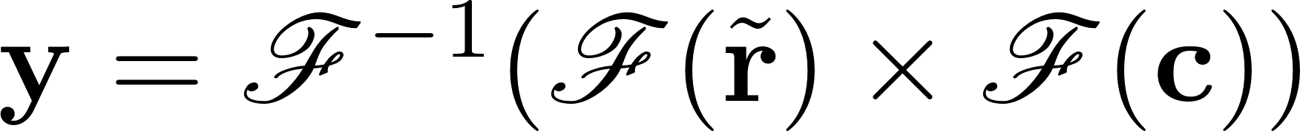


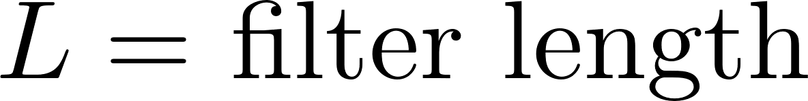
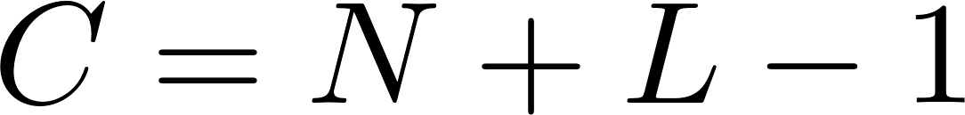
Convolution - Single Convolution
Time domain
Frequency domain

Slide 30

Convolution - Single Convolution Block Diagram
Time domain
Frequency domain
FFT
Time-domain Convolution
Complex
Multiplication
IFFT
Scalar Multiplication
Time-domain Convolution
FFT

Slide 31
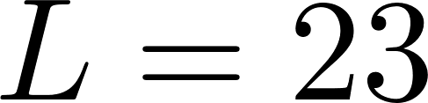
Batch Convolution - Flops vs. GPU Execution Time
tap detection filter

Slide 32
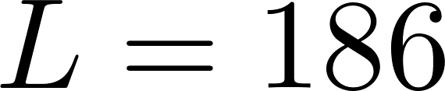
Batch Convolution - Flops vs. GPU Execution Time
tap equalizer filter

Slide 33
Introduction - PAQ Signal Processing
186 Taps
23 Taps
Preamble
Detector
Equalize
Detection
Filter
2
Frequency
Offset
Estimator
PLL
Estimators
1.907 Seconds is 3103 or 3104 iNET Packets

Slide 34
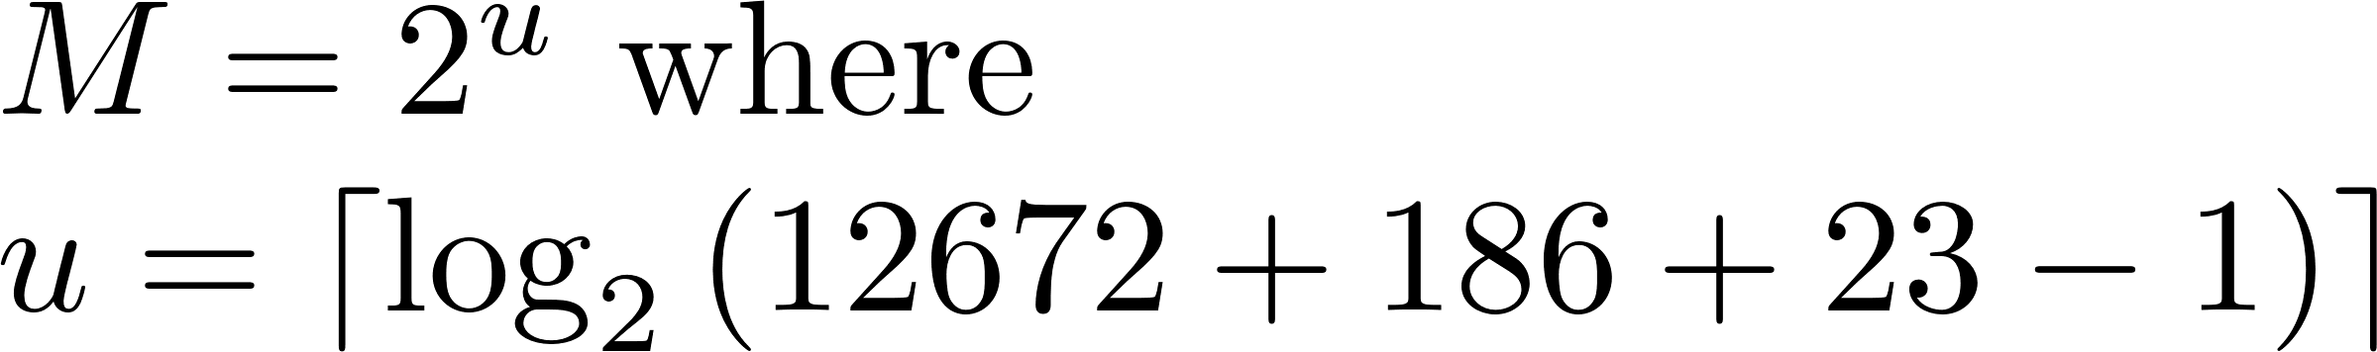
Convolution - Cascaded Convolution
Time domain
Frequency domain

Slide 35
Convolution - Cascaded Convolution Block Diagram
Time domain
Frequency domain
FFT
Time-domain Convolution
FFT
Complex
Multiplication
IFFT
Scalar Multiplication
Time-domain Convolution
FFT

Slide 36
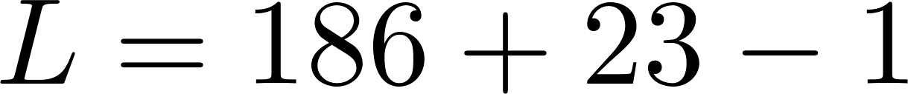
Batch Convolution - Flops vs. GPU Execution Time
tap detection filter

Slide 37










Compute & Apply Equalizers
Compute ZF
Filter
Apply Filters
OQPSK
Detector
Compute MMSE
Filter
Apply Filters
OQPSK
Detector
Compute CMA
Filter
Apply Filters
OQPSK
Detector
Compute FDE1
Apply Filters
OQPSK
Detector
Compute FDE2
Apply Filters
OQPSK
Detector

Slide 38
Computing Equalizers
ZF & MMSE
CMA
FDE1 & FDE2

Slide 39
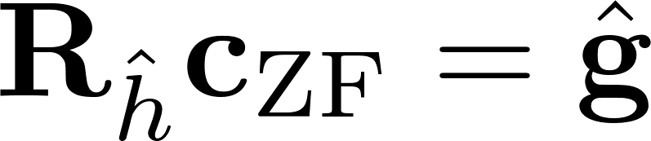
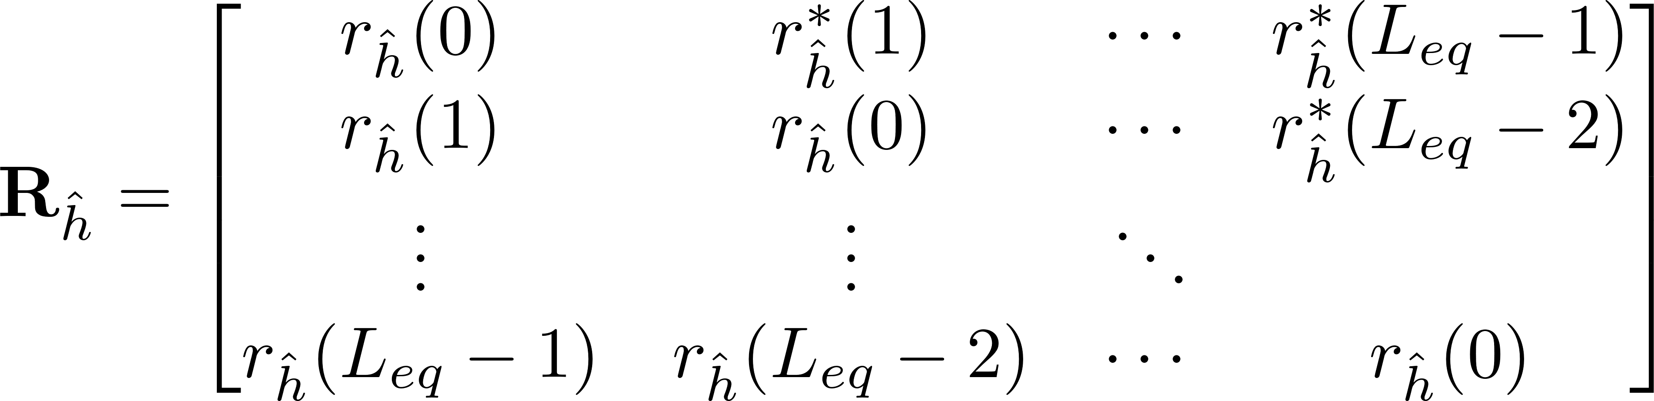
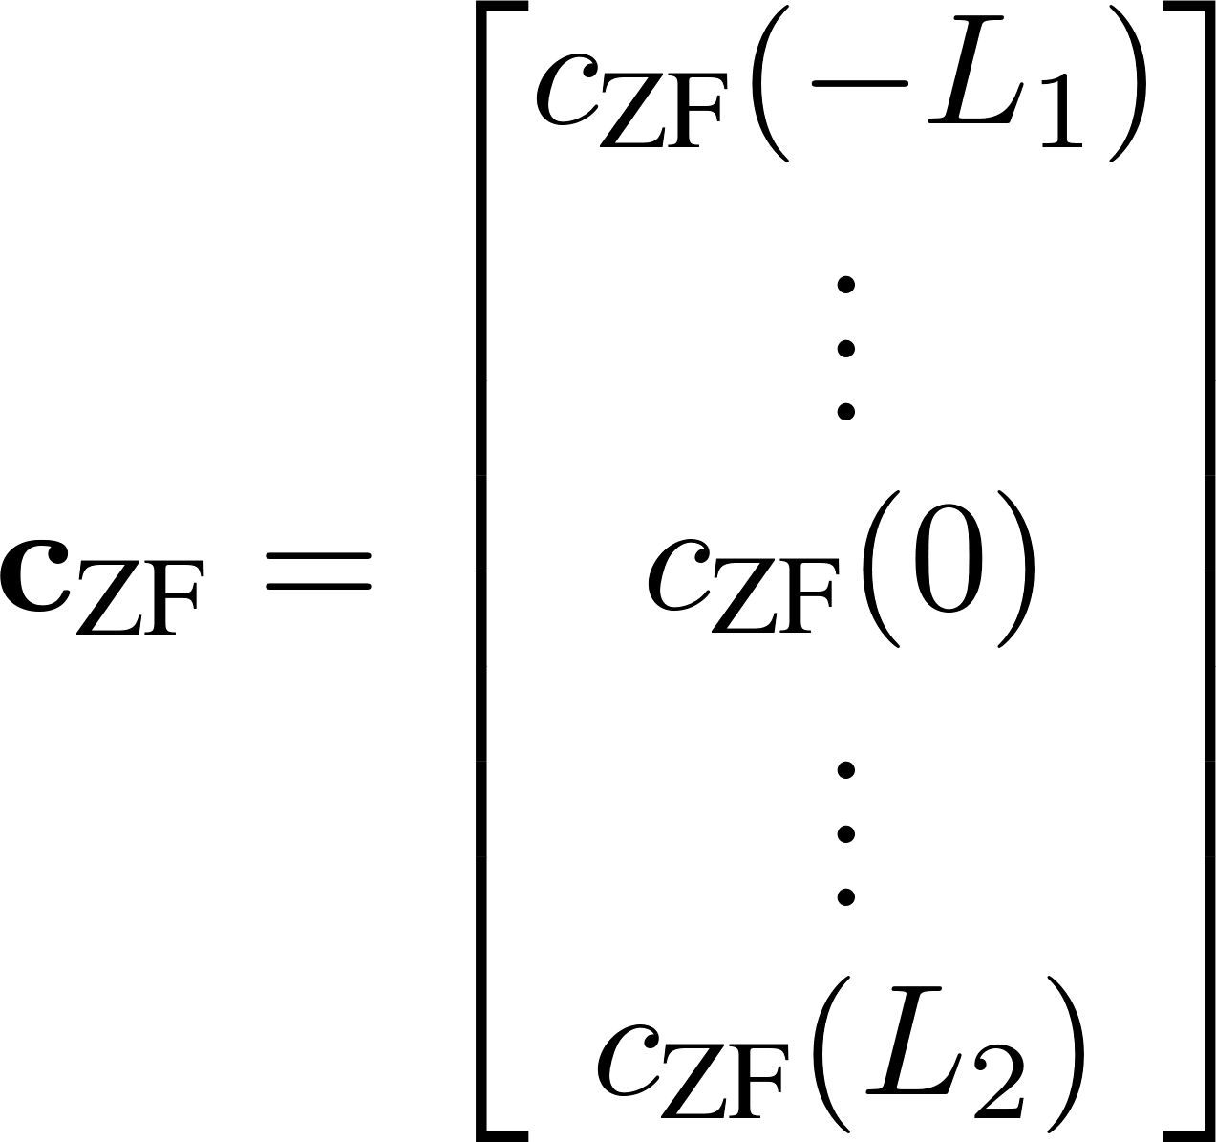
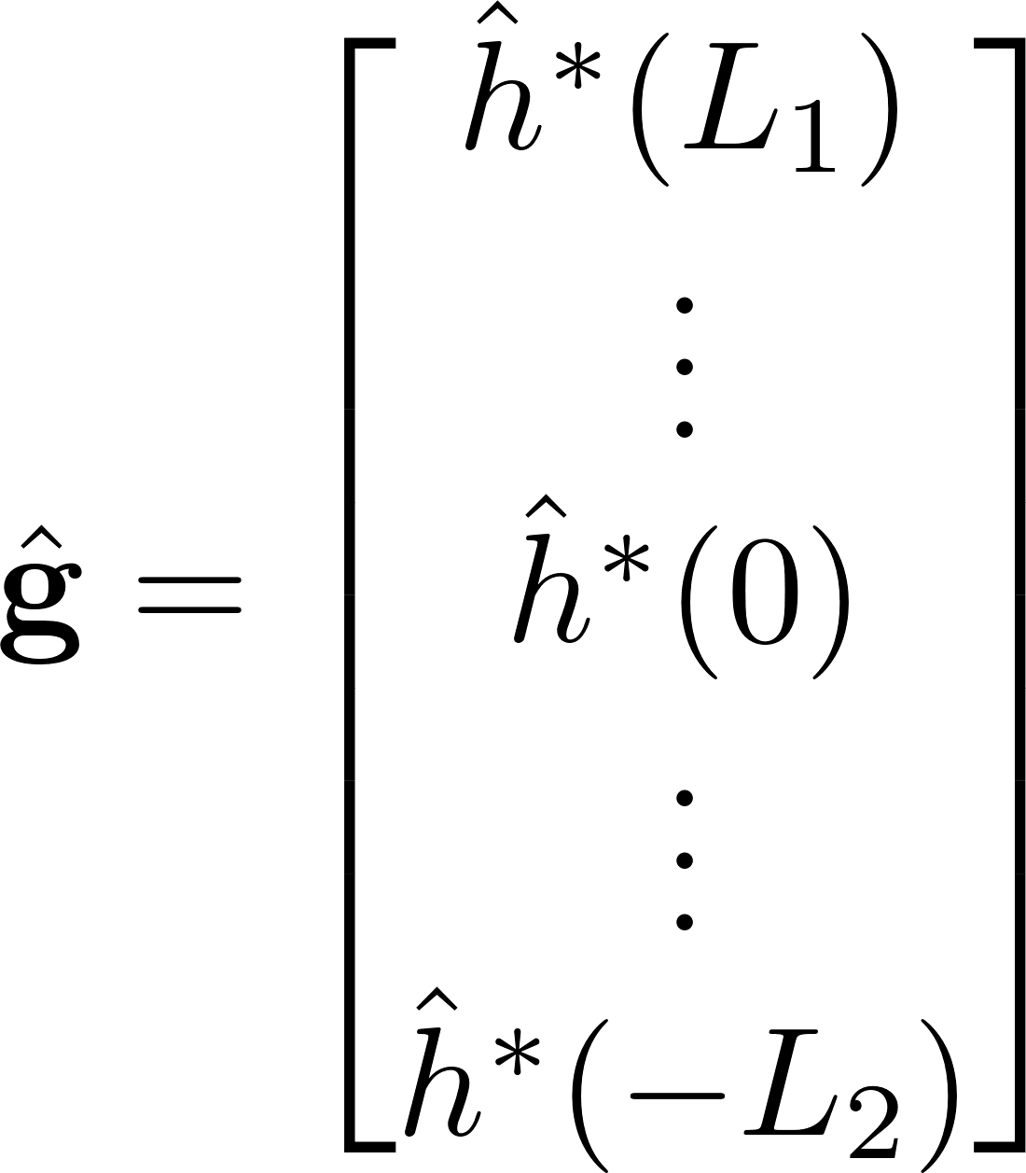
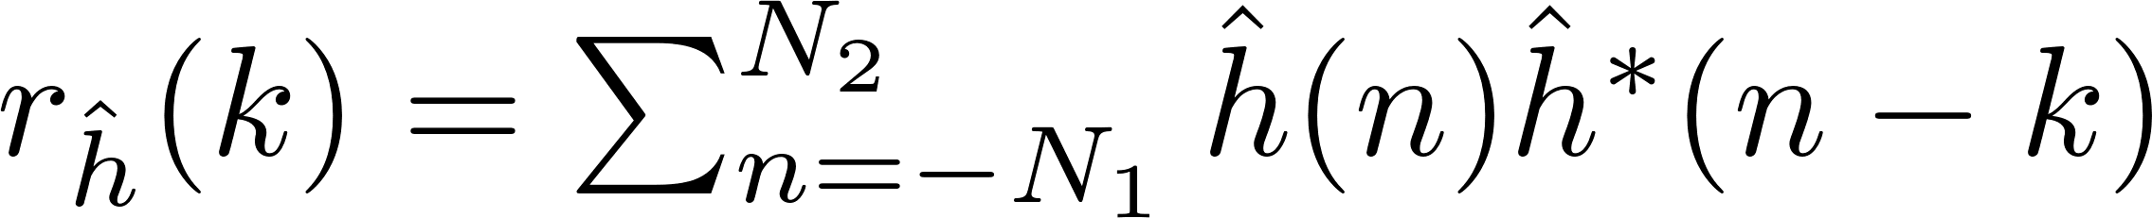
ZF Equations

Slide 40
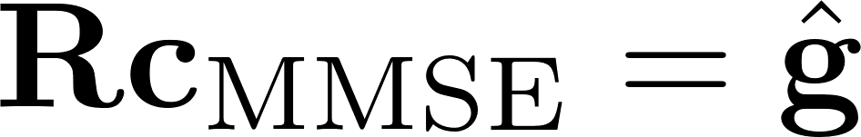
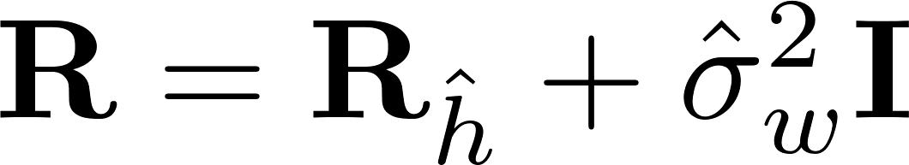
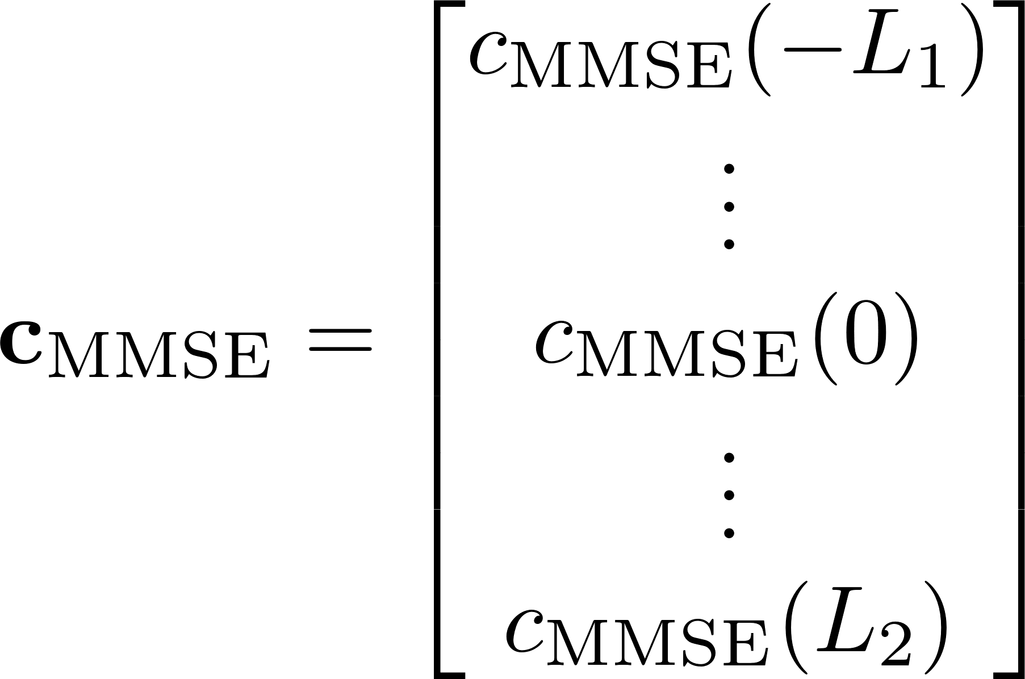
MMSE Equations

Slide 41
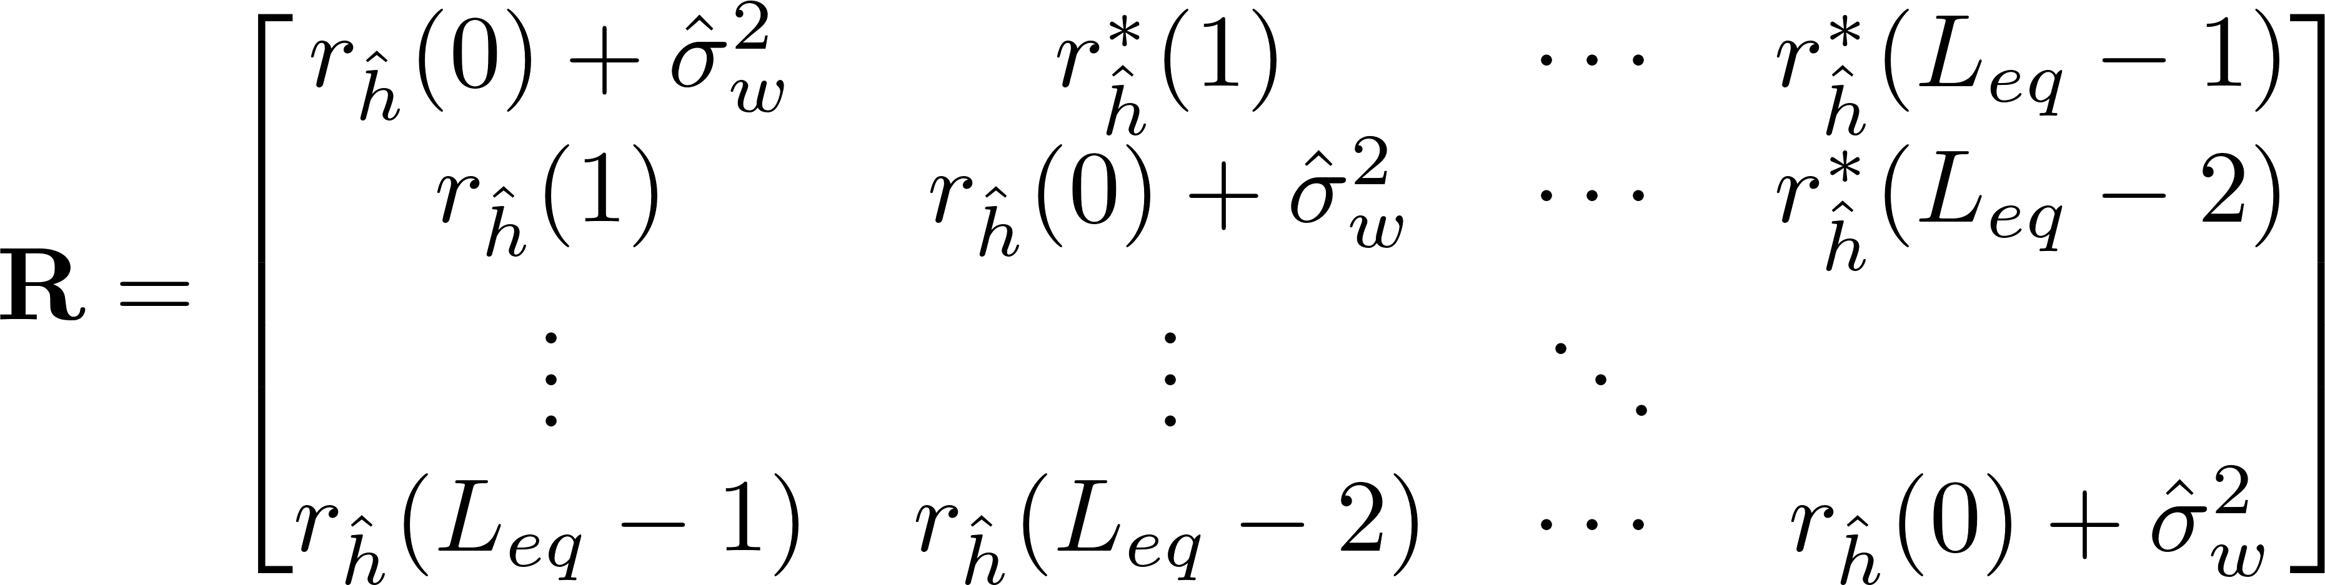
ZF & MMSE Equations
ZF
MMSE

Slide 42


Computing ZF & MMSE
Levinson-Durbin recursion algorithm to solve by
leveraging the toeplitz property of
cuBLAS LU decomposition library to compute the inverse and matrix vector multiplication defined by
Using the cuSolverSp library to solve by leveraging the sparse property of

Slide 43
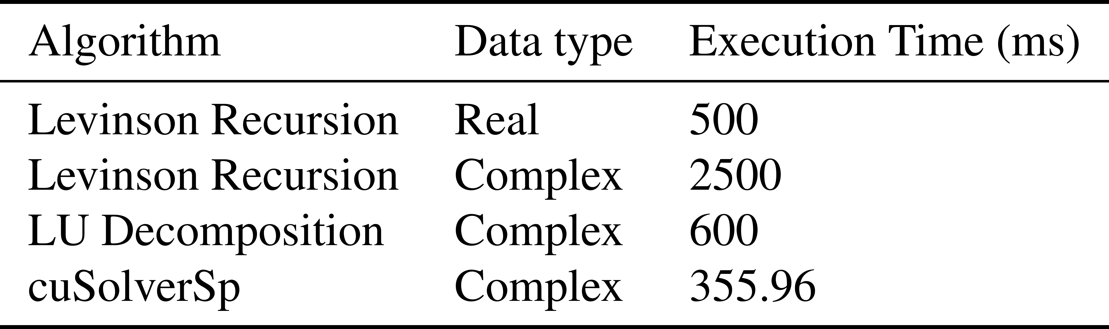
Computing ZF & MMSE

Slide 44



Computing & Applying ZF Using cuSolverSp
Fill Vector
cuSolverSp
Frequency-domain Convolution
Fill CRS
Matrix
Auto-
Correlation

Slide 45

Computing & Applying MMSE Using cuSolverSp
Fill Vector
cuSolverSp
Frequency-domain Convolution
Fill CRS
Matrix
Auto-
Correlation

Slide 46
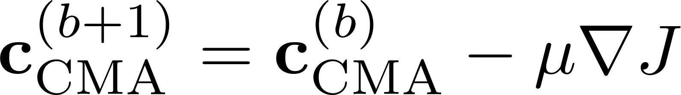
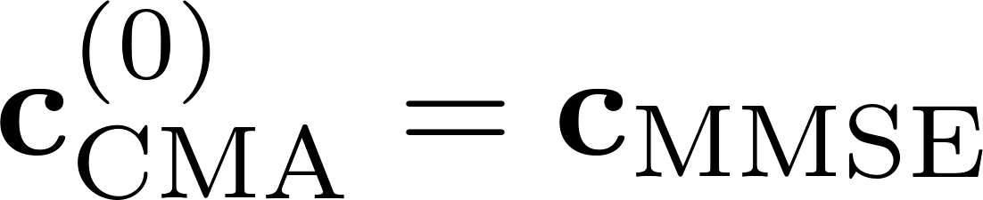
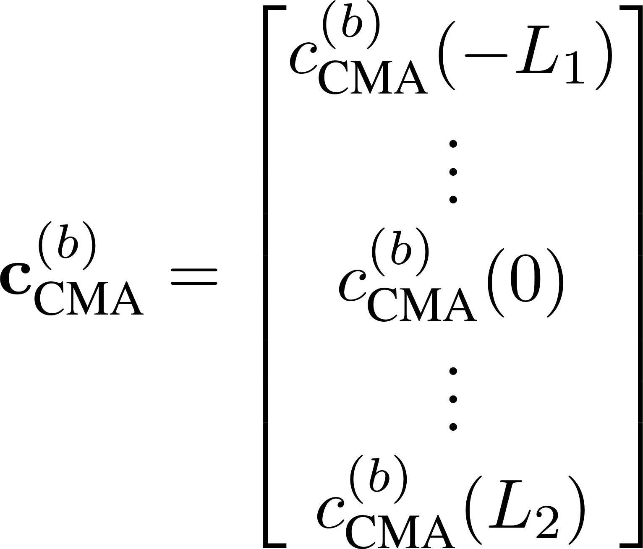
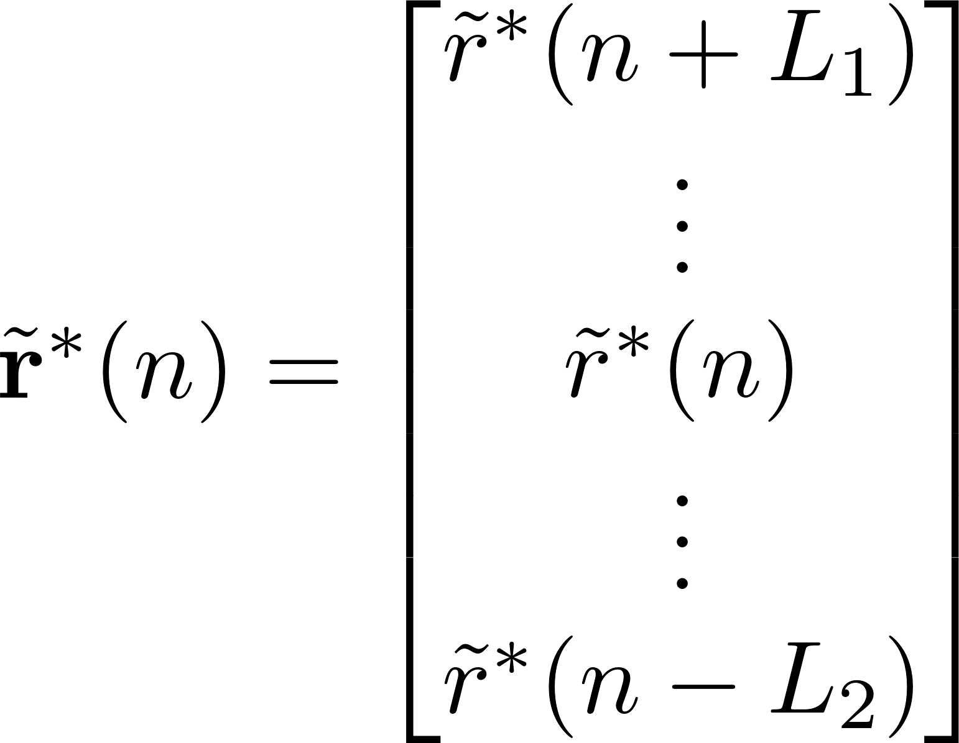
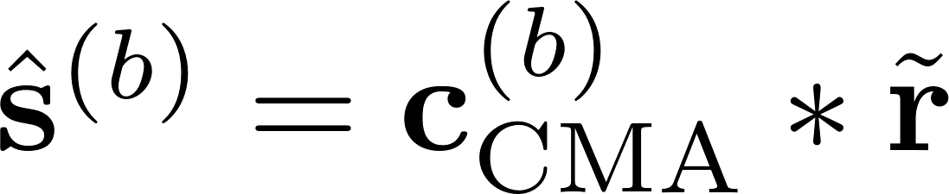
CMA Equations

Slide 47
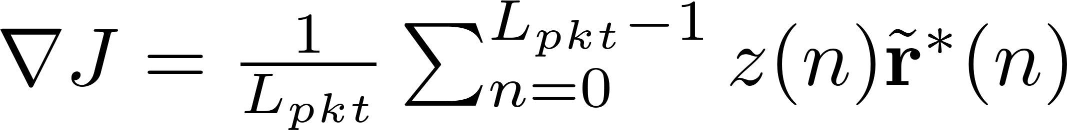
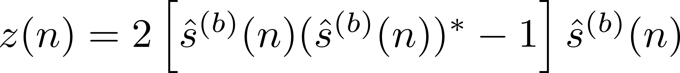
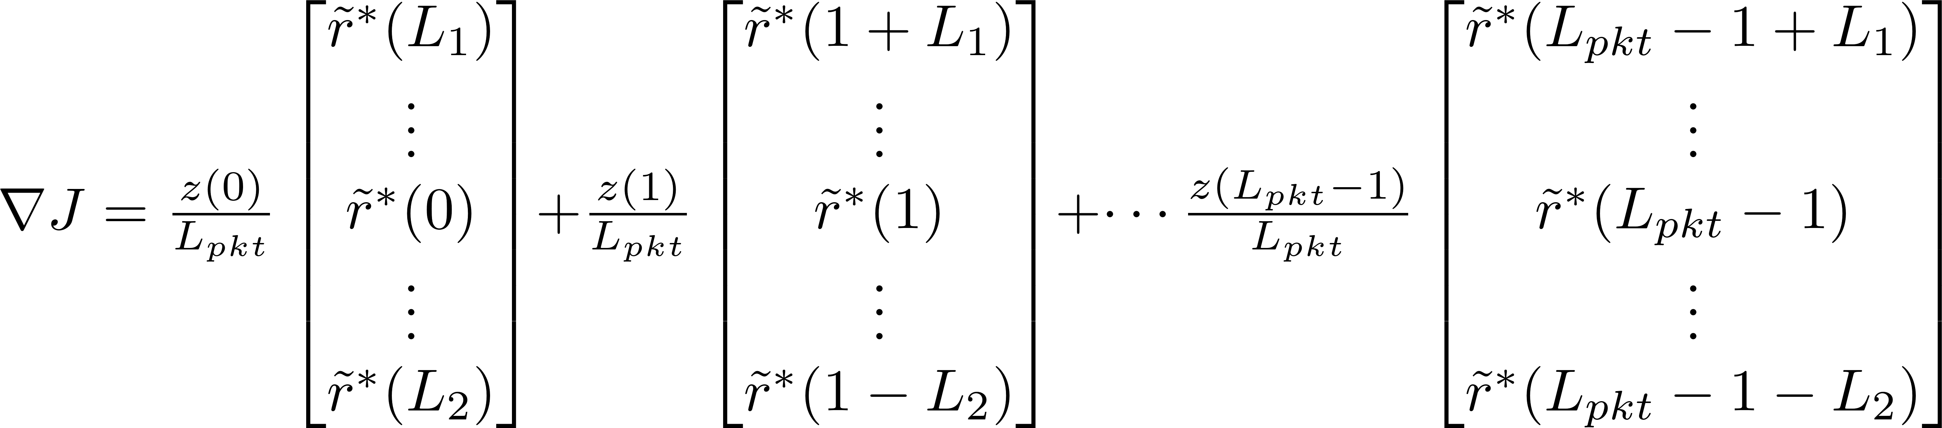
CMA Equations

Slide 48
CMA Equations

Slide 49

Computing CMA
The bottleneck in the CMA equalizer is computing
can be computed by:
Implementing directly
Reformulating into convolution to leverage GPU convolution

Slide 50
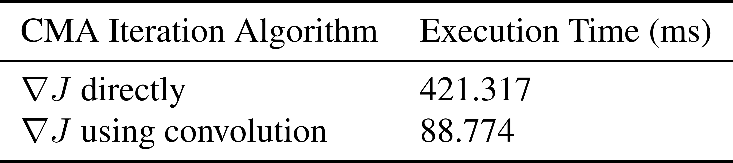
Computing CMA

Slide 51
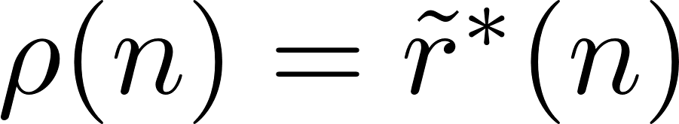
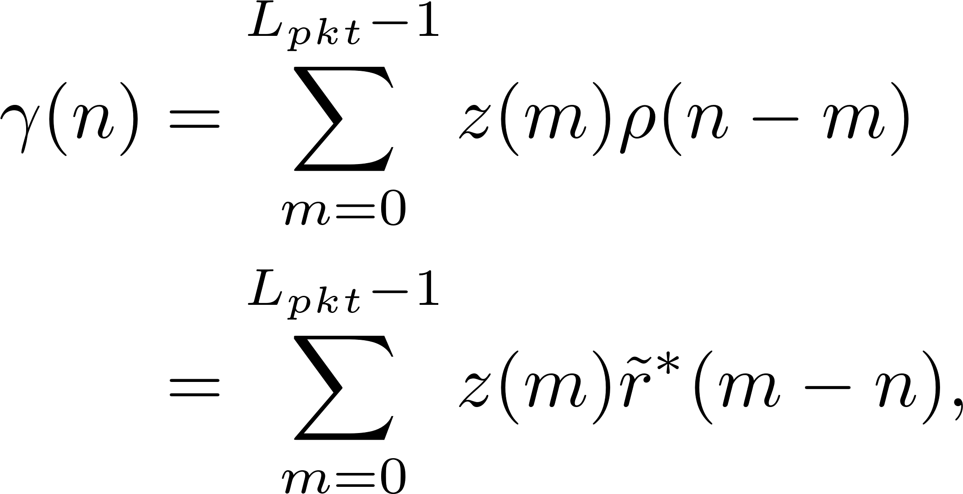
Reformulating CMA Equations

Slide 52
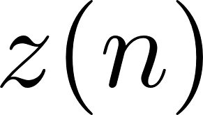

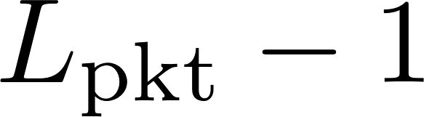

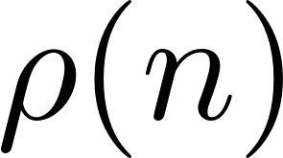
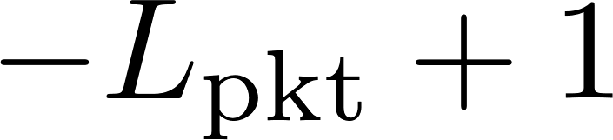
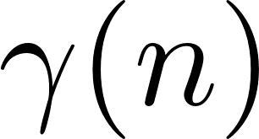
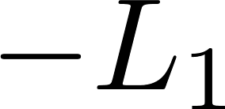
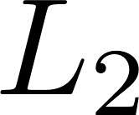
Reformulating CMA Equations

Slide 53

Reformulating CMA Equations

Slide 54





Computing & Applying CMA Using Convolution
Frequency-domain Convolution
Multiply
Frequency-domain Convolution
Steepest Descent
Conjugate Time Reversal
Frequency-domain Convolution

Slide 55






Computing & Applying FDE1 & FDE2

Slide 56

Computing & Applying FDE1 & FDE2

Slide 57
Computing & Applying FDE1
FFT
Point-to-point
Multiplication & Division
IFFT
FFT

Slide 58
Computing & Applying FDE2
FFT
Point-to-point
Multiplication & Division
IFFT
FFT

Slide 59
Pipelineing CPU and GPUs
Estimators
GPU0
Preamble
Detector
Compute
MMSE
CMA
Iterations
CMAFilter
OQPSK
Demod
GPU1
GPU0 to GPU1
Transfer
Compute
ZF
ZF Filter
OQPSK
Demod
MMSE
Filter
OQPSK
Demod
GPU2
Resampling
Polyphase Filters
GPU1 to GPU2
Transfer
FDE1Filter
OQPSK
Demod
FDE2 Filter
OQPSK
Demod
GPU0 to Host
Transfer
CPU
Host to GPU0
Transfer
CPU to FPGA
Transfer
CPU
Acquire ADC Data
CPU
Synchronize

Slide 60
Static Multipath Test Setup
SOQPSK-TG TX
Multipath
Channel
Host CPU
FPGA
RF
Noise
Source
Bits & Clk
Power Splitter
T/M Receiver
Preamble Scrubber
BERT
Bits & Clk
Bits & Clk
ADC
Host CPU
Host CPU
FPGA
FPGA
Samples
70 MHz IF
Spectrum
Analyzer
K40c GPU
K20c GPU
K20c GPU
Rack Mounted Server

Slide 61


Channel 1

Slide 62


Channel 2

Slide 63


Channel 3

